Slide 1
Portal APIs
Focus Area: Foundation

Slide 2
Training Overview
Group Workshop
Back-end
Front-end
Services
Integration
Content
Services
Advanced
Security
Widget Development
Widget
Extras
Targeting
Publishing
Container
Development
Foundation
Portal Essentials
Portal Technologies
Portal Tools
Portal APIs
Notes:
KEY
New module
HOW
Briefly, introduce the module to participants
TIME
1 min

Slide 3
Objectives
Foundational knowledge of APIs
Understanding the REST API
Awareness of the Java API
Awareness of the client API
Notes:
KEY
Module objectives
HOW
Briefly, introduce the module objectives
TIME
1 min

Slide 4
Introduction
Portal APIs

Slide 5
Introduction
API = Application Programming Interface
A specification intended to be used as an interface by software components to communicate with each other
An API may include specifications for routines, data structures, object classes, and variables
An API can be:
language dependent (e.g. Java, Javascript)
language independent
Can be called from several programming languages
Service-oriented APIs (REST, SOAP)
Notes:
KEY
API definition
HOW
Explain what is an API in general terms
Explain how systems and frameworks expose their interfaces
TIME
2 min

Slide 6
CXP APIs
Language independent API
Backbase Client
Portal Manager
Client Side Logic
Other REST Clients
Backbase Client API
Portal Explorer
REST API
Java API
Server Side Logic
Portal Server
Language dependent APIs
Notes:
KEY
CXP API
HOW
Portal Server exposes a JAVA API so we can communicate with the portal server when building Java components
on top of the JAVA API, we provide the REST API
the REST API makes calls to the JAVA API
REST API is language independent so that widgets can use it too
Every action in CXP Manager (creating pages, dropping a new widget, etc..) is a REST call
Client API is part of Portal Client, it is a JS API that widgets can use to communicate with the Java API
TIME
3 min

Slide 7
REST API
Portal APIs

Slide 8
REST
Representational
XML, JSON, HTML…
State
More concerned with state of resource than with actions
Transfer
Transferring resource data in some representational form
Notes:
KEY
REST definition
HOW
Resource-centric approach
Every resource (object in the model) has one or more URIs
The state of the resource has a representation or format for exchanging purposes
TIME
2 min

Slide 9
REST
Architectural style, resource-centered
Compare to service-centered style
Key principles:
Give every item an ID (URL)
Link items together
Use standard methods
HTTP: POST, GET, PUT, DELETE
Resources can have multiple representations
Stateless communication
Server should not have to retain communication state for any of its clients beyond a single request
Notes:
KEY
REST definition
HOW
Explain that REST makes use of standard HTTP methods
TIME
2 min

Slide 10
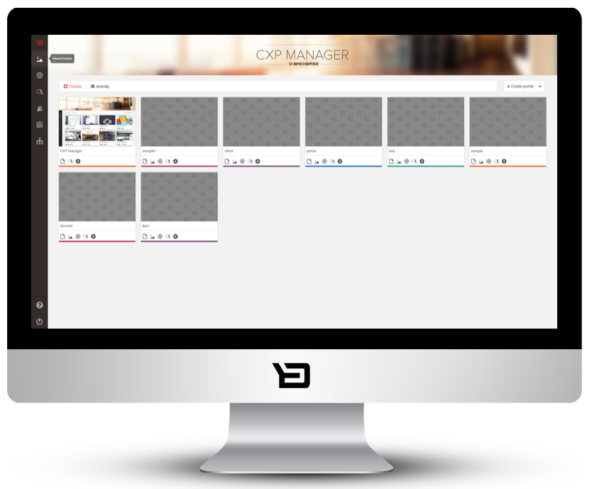
CXP REST API
CXP Manager uses the REST API
Manipulate the portal model
portals, pages, containers, widgets
Manage users and groups
Common XSD schema definition
CRUD operations (create, read, update, delete), sorting, filtering, paging
REST API
Notes:
KEY
CXP Manager and REST API
HOW
Explain that CXP manager is nothing more than a UI that makes use of the API
TIME
2 min

Slide 11
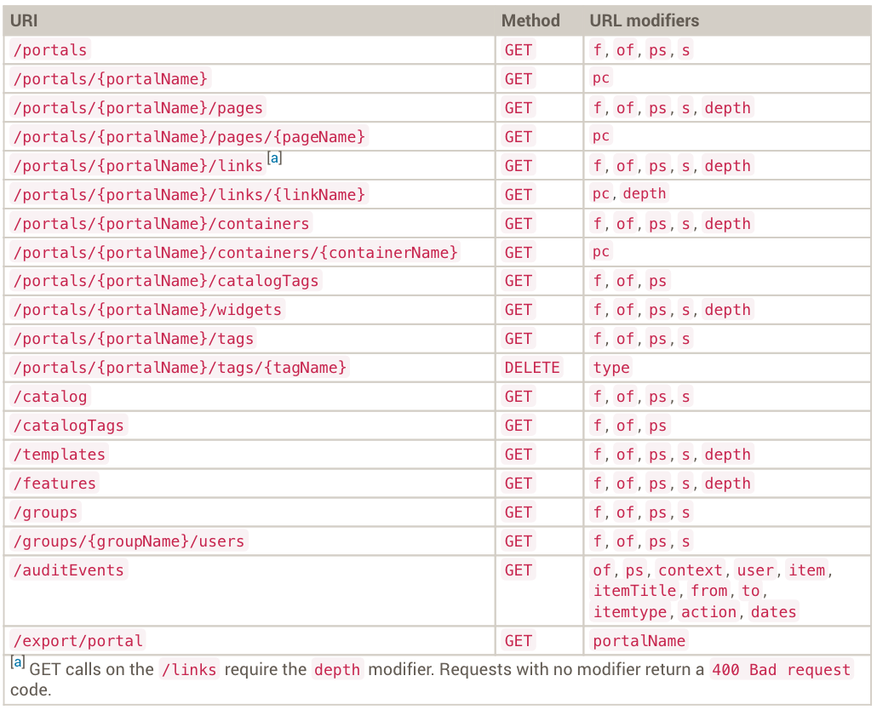
REST API – Syntax
Notes:
KEY
Syntax
HOW
No need to remember these URLs. Check the documentation on my.backbase:
https://my.backbase.com/docs/product-documentation/documentation/portal/5.6.2/rest_portalservices_urlmod.html#/list
TIME
2 min

Slide 12
REST API: URL Modifiers
It is possible to run REST API queries about items specifying modifiers and parameters
Types of modifiers:
Filter queries (f)
Sorting (s)
Paging (ps, of)
Processing children (pc, depth)
Notes:
KEY
URL modifiers
HOW
Explain the different set of modifiers
Examples:
Use filters to return pages whose name starts with “I”
Paging results using ps (page size) and of (offset)
TIME
2 min

Slide 13
REST API: URL Modifiers - Filter
Filter queries (f)
The following syntax is supported:
?f=element_name(operator)value Filters elements by <name> elements.
?f=property.property_name(operator)value Filters elements by the value of a property.
Available operators: lt, gt, eq, not, like
Example: /portals?f=property.DefaultLandingPage(eq)index
Notes:
KEY
Filtering
HOW
Explain that filters have a particular syntax
Examples:
http://localhost:7777/portalserver/portals?f=name(like)retail
http://localhost:7777/portalserver/portals/retail-demo/pages?f=property.title(like)Account
TIME
2 min

Slide 14
REST API: URL Modifiers - Sorting
Sorting (s)
Sorts results of queries in either ascending or descending order
The syntax: s=element_name(asc|dsc)
asc – (ascending)
dsc – (descending)
Example: /portals/[portal_name]/pages?s=name(asc)
Notes:
KEY
Sorting
HOW
Explain the sorting feature
Example: http://localhost:7777/portalserver/portals/retail-demo/pages?s=property.title(dsc)
TIME
1 min

Slide 15
REST API: URL Modifiers - Paging
Paging results (ps, of)
Paging modifiers allow us to page responses:
ps – the number of results in the response. The default page size varies per object.
of – the number of results to be skipped in the response. Defaults to 0.
Example: /portals/[portal_name]/widgets?of=8&ps=4
Notes:
KEY
Paging
HOW
Explain how to page results
Example:
http://localhost:7777/portalserver/catalog?ps=10&of=0 (first page with 10 elements)
http://localhost:7777/portalserver/catalog?ps=10&of=10 (second page with 10 elements)
TIME
2 min

Slide 16
REST API: URL Modifiers - Children
Processing children (pc, depth)
Specify whether the children of an item will be processed or not:
pc – applies to GET requests on the URLs that process items capable of containing child items. If set to false, the response does not include the object children. Defaults to true.
depth – specifies the number of children levels to be displayed.
Notes:
KEY
Processing children
HOW
Explain that item has children and we can configure how to display them
Example:
http://localhost:7777/portalserver/portals/retail-demo/pages?f=property.title(eq)Home&pc=true&depth=3
TIME
2 min

Slide 17
Demo: REST API Examples
Returns the list of portals /portals
Returns the portal model /portals/{portal_name}.xml
Returns a list of pages from 5 to 10, sorted ascending by name /portals/{portal_name}/pages.xml?of=5&ps=5&s=name(asc)
Notes:
KEY
Demos
HOW
Show some examples using the GET verb
TIME
5 min

Slide 18
Demo: REST API Representational Formats
An item can be requested in either HTML or XML format, depending on the extension of the request
REST API response formats
.html
.xml
Notes:
KEY
Representation formats
HOW
Do a get request and change the extension to show that one time it returns the XML and the other time the HTML format of the model structure.
.XML
.HTML
Example:
http://localhost:7777/portalserver/portals/retail-demo/pages/<page-name>.xml
http://localhost:7777/portalserver/portals/retail-demo/pages/<page-name>.html
TIME
5 min

Slide 19
Workshop: REST API
Get all the widgets in a portal sorted by name
Create a new user
Notes:
KEY
Exercises
HOW
Show how to retrieve the API documentation using MyBackbase.
To get all widgets in a portal:
GET http://localhost:7777/portalserver/portals/[portal_name]/widgets?s=name(asc)
To create a new user
POST http://localhost:7777/portalserver/users
<user>
<username>testUser1</username>
<password>123456</password>
<enabled>true</enabled>
<groups>
<group>
<name>admin</name>
</group>
</groups>
<properties/>
</user>
TIME
10 minutes

Slide 20
Demo: Portal Manager Using REST API
Portal Manager uses REST API to communicate with Portal Server
Notes:
KEY
Show the API usage when working with CXP Manager
HOW
Go to Portal Manager -> My Portal -> Pages
Open firebug/inspect tool, switch to the Network tab
Manipulate the model (drag and drop a new widget, or delete an instance) and show how this will fire some REST API calls
TIME
5 min

Slide 21
Java API
Portal APIs

Slide 22
Java API
https://docs.backbase.com/portal/5.6.2/javadocapi/index.html
Important business services defined in
com.backbase.portal.foundation.business.service
Used in custom server logic instead of the REST API
Internally used by the REST API
Notes:
KEY
Java API
HOW
Show the API documentation
TIME
1 min

Slide 23
Java API – Important Interface/Classes
Package com.backbase.portal.foundation.business.service
PortalBusinessService
GroupBusinessService
ItemBusinessService
Instances created by portal server as beans:
@Autowired private ItemBusinessService<Item> itemBusinessService;
or
HttpServletRequest req = (HttpServletRequest) pageContext.getRequest();
ApplicationContext cxt = RequestContextUtils.getWebApplicationContext(req);
ItemBusinessService<Item> itemService = cxt.getBean("itemBusinessService",ItemBusinessService.class);
Notes:
KEY
Important classes
HOW
Briefly describe some services
TIME
1 min

Slide 24
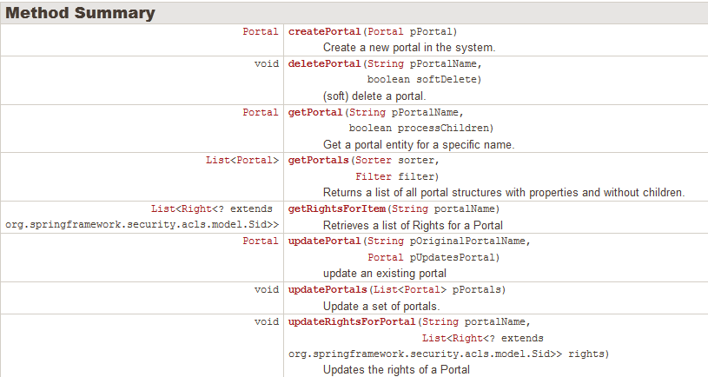
Java API – PortalBusinessService
com.backbase.portal.foundation.business.service
Notes:
KEY
An example of service
HOW
Use the PortalBusinessService as an example
TIME
1 min

Slide 25
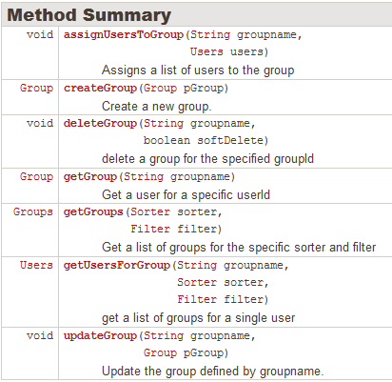
Java API – GroupBusinessService
com.backbase.portal.foundation.business.service
Notes:
KEY
Another example of service
HOW
Use the GroupBusinessService as an example
TIME
1 min

Slide 26
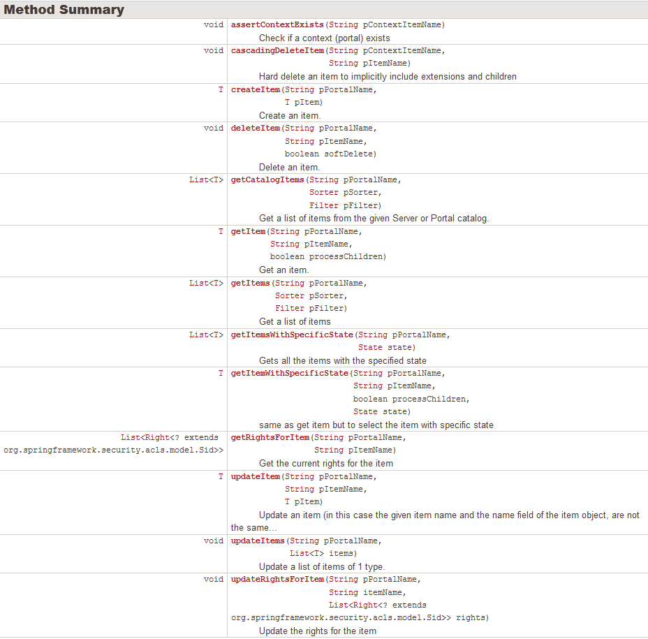
Java API – ItemBusinessService
com.backbase.portal.foundation.business.service
Notes:
KEY
Another example of service
HOW
Use the ItemBusinessService as an example
TIME
1 min

Slide 27
Java API – ItemBusinessService
com.backbase.portal.foundation.business.service
Notes:
KEY
Another example of service
HOW
Use the ItemBusinessService as an example
TIME
1 min

Slide 28
Java API - Events
AddGroupsToUserEvent
AssignUsersToGroupEvent
BeforeServerSideRenderingEvent
BeforeURLCacheResponseEvent
ContentEvent
CreateContentEvent
CreateGroupEvent
CreateItemEvent
CreateUserEvent
DeleteContentEvent
DeleteGroupEvent
DeleteItemEvent
DeleteUserEvent
GroupEvent
GroupUserEvent
ItemCollectionTransformedEvent
ItemEvent
NonAuditableItemUpdateEvent
PublishingApproveEvent
PublishingCreateSetEvent
PublishingEvent
PublishingFailEvent
PublishingRejectEvent
PublishingUnlockEvent
RemoveAllUsersFromGroupEvent
RemoveUserFromGroupEvent
UpdateContentEvent
UpdateGroupEvent
UpdateItemEvent
UpdateItemListEvent
UpdateItemRightsEvent
UpdateUserEvent
UrlLevelCacheRemovalEvent
UserEvent
CXP will notify listeners of many important events:
Notes:
KEY
Event handling
HOW
BeforeServerSideRenderingEvent Allows one to apply any custom transformations to the model just before the rendition and after all the usual transformations (security, user preferences etc) have already been applied
TIME
1 min

Slide 29

JavaScript API
Portal APIs
Portal APIs

Slide 30
Javascript API
Javascript API is a Javascript wrapper around the REST API
b$.portal.loggedInUserId =>"admin”
b$.portal.portalName => “training-portal”
b$.portal.config.serverRoot => "/portalserver"
Notes:
KEY
JavaScript API
HOW
WE NEED TO TELL MORE ABOUT THIS
TIME
1 min

Slide 31
Points to Remember
Language dependent and language independent APIs
REST API
Java API
Client API

